Slide 1
Data Mining Engineering

Slide 2
Outline
Process Model and Methodology
SE Process Models
  IEEE STD 1074
  ISO 12207
CRISP-DM
SE Process Model vs CRSP-DM
Process Model for Data Mining Engineering
Comparison of KDD process model vs CRISP-DM

Slide 3
Process Model
Set of tasks to be performed to develop a particular element, as well as the elements that are produced in each task (outputs) and the elements that are necessary to do a task (inputs
Ultimate goal of process model is to make the process
  Repeatable
  Manageable
  Measurable

Slide 4
Process Model should be …
Effective
Maintainable
Predictable
Repeatable
Quality
Improvable
Traceable

Slide 5
Methodology
Instance of a Process Model
Lists
  Tasks
  Inputs
  Outputs
  Specifies how to do the tasks
    Technique to do specified task
    Tools used to improve technique

Slide 6
Process model denote
  What to do
Methodology indicate
  How to do it
Life Cycle
  Determines the order in which each activity is to be done
  Description of the different ways of developing a project

Slide 7
What do we have in Data Mining ….?
  Process Model ?
  Methodology ?
  Life Cycle ?
from engineering point of view …..

Slide 8
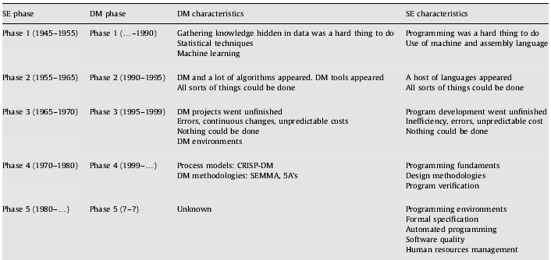
Parallelism between DM and SE

Slide 9
Software Engineering Process Model
IEEE STD 1074
ISO 12207

Slide 10
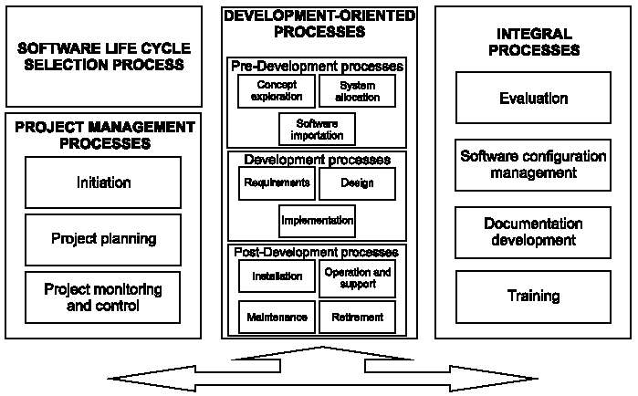
IEEE STD 1074

Slide 11
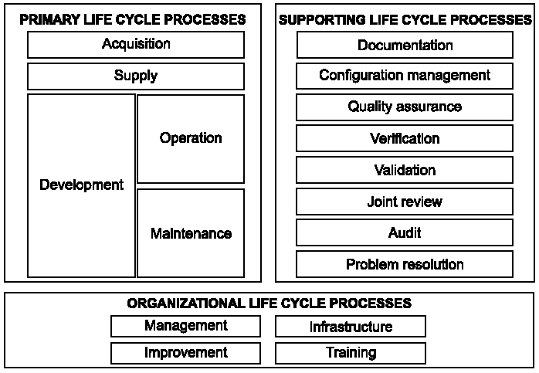
ISO 12207

Slide 12
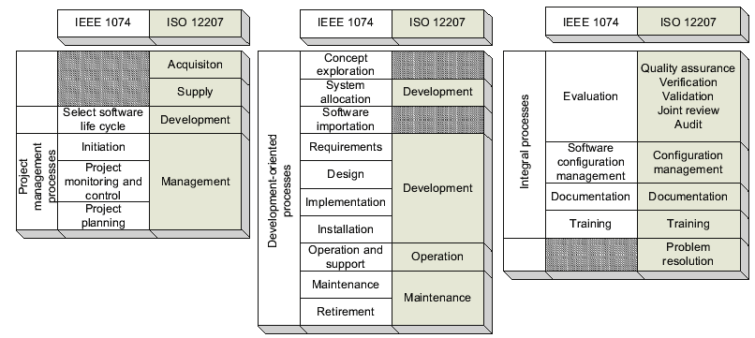
Mapping ISO 12207 to IEEE STD 1074

Slide 13
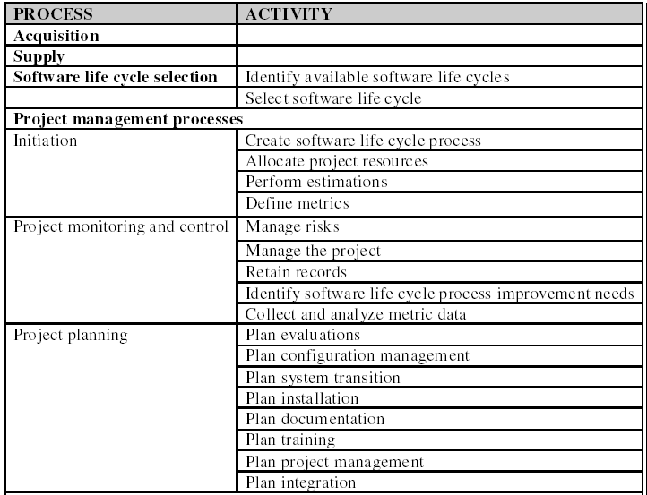
Joint Process Model

Slide 14
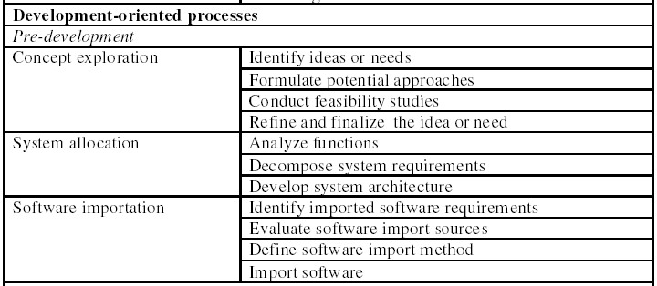
Joint Process Model …

Slide 15
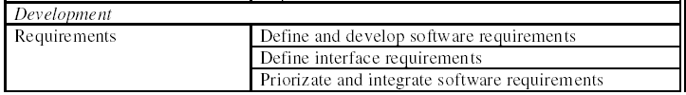
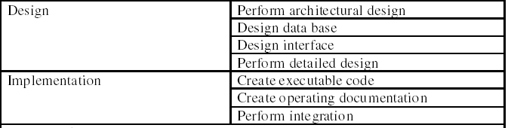
Joint Process Model …

Slide 16
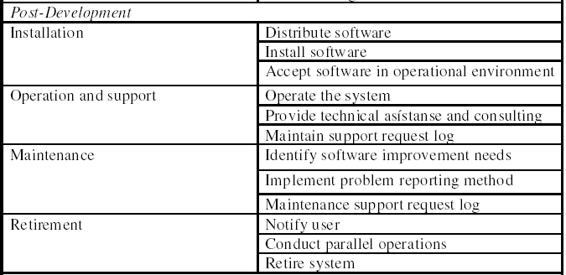
Joint Process Model …

Slide 17
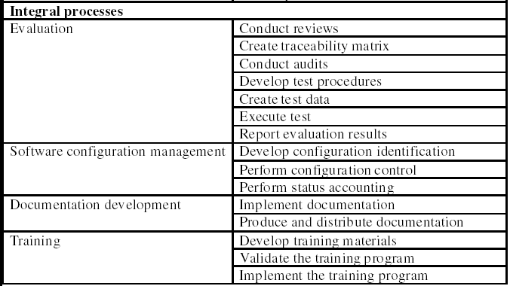
Joint Process Model …

Slide 18
CRISP-DM
CRoss Industry Standard Process
for Data Mining
Guideline proposed by enterprises
  Teradata (NCR)
  SPSS (ISL)
  Daimler-Chrysler
  OHRA
based on their experiences

Slide 19
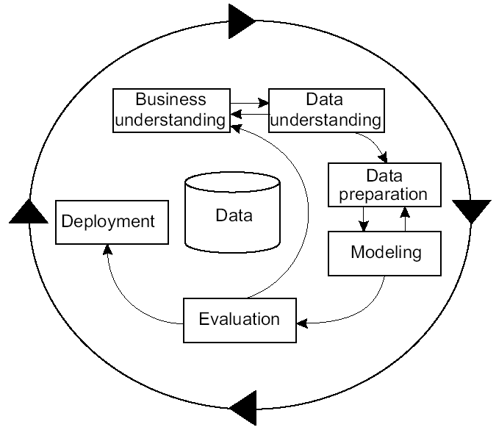
CRISP-DM

Slide 20
CRISP-DM …
Business Understanding
This initial phase focuses on understanding the project objectives and requirements from a business perspective, and then converting this knowledge into a data mining problem definition, and a preliminary plan designed to achieve the objectives.
Data Understanding
The data understanding phase starts with an initial data collection and proceeds with activities in order to get familiar with the data, to identify data quality problems, to discover first insights into the data, or to detect interesting subsets to form hypotheses for hidden information.

Slide 21
CRISP-DM …
Data Preparation
The data preparation phase covers all activities to construct the final dataset (data that will be fed into the modeling tool(s)) from the initial raw data. Data preparation tasks are likely to be performed multiple times, and not in any prescribed order. Tasks include table, record, and attribute selection as well as transformation and cleaning of data for modeling tools.
Modeling
In this phase, various modeling techniques are selected and applied, and their parameters are calibrated to optimal values. Typically, there are several techniques for the same data mining problem type. Some techniques have specific requirements on the form of data. Therefore, stepping back to the data preparation phase is often needed.

Slide 22
CRISP-DM …
Evaluation
At this stage in the project you have built a model (or models) that appears to have high quality, from a data analysis perspective. Before proceeding to final deployment of the model, it is important to more thoroughly evaluate the model, and review the steps executed to construct the model, to be certain it properly achieves the business objectives. A key objective is to determine if there is some important business issue that has not been sufficiently considered. At the end of this phase, a decision on the use of the data mining results should be reached.

Slide 23
CRISP-DM …
Deployment
Creation of the model is generally not the end of the project. Even if the purpose of the model is to increase knowledge of the data, the knowledge gained will need to be organized and presented in a way that the customer can use it. Depending on the requirements, the deployment phase can be as simple as generating a report or as complex as implementing a repeatable data mining process. In many cases it will be the customer, not the data analyst, who will carry out the deployment steps. However, even if the analyst will not carry out the deployment effort it is important for the customer to understand up front what actions will need to be carried out in order to actually make use of the created models.

Slide 24
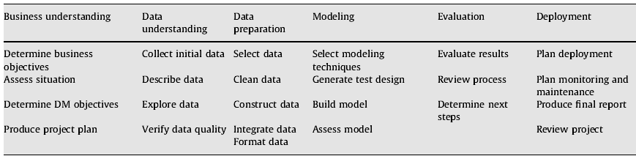
CRISP-DM phases and tasks

Slide 25
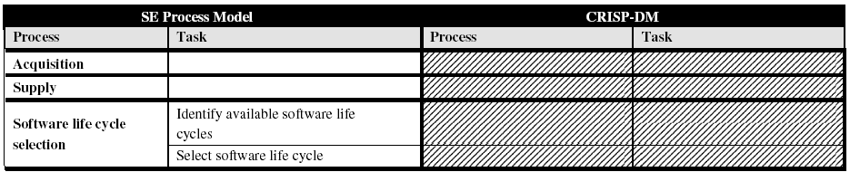
SE process model vs CRISP-DM

Slide 26
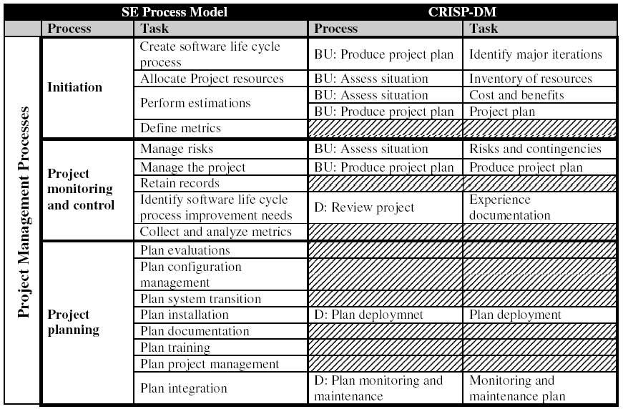
SE process model vs CRISP-DM
BU: Business Understanding D: Deployment

Slide 27
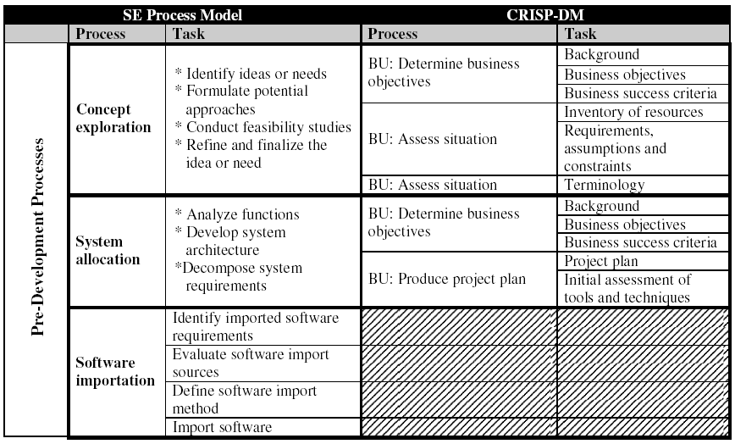
SE process model vs CRISP-DM

Slide 28
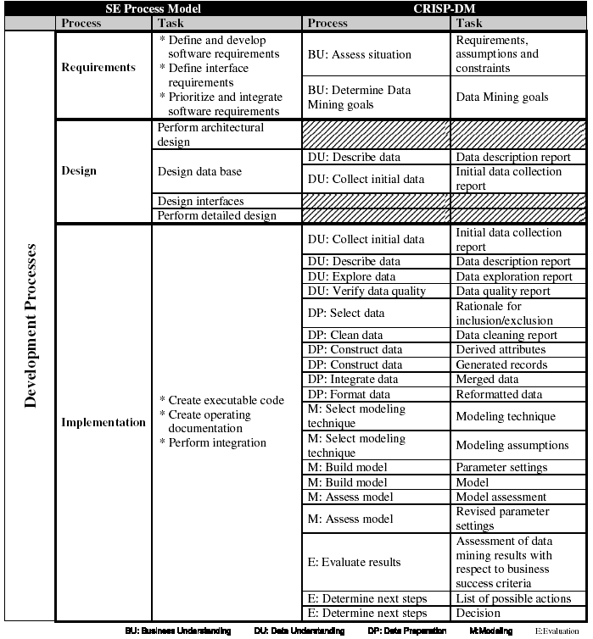

Slide 29
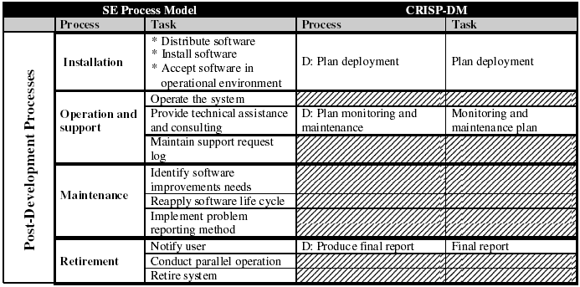
SE process model vs CRISP-DM

Slide 30
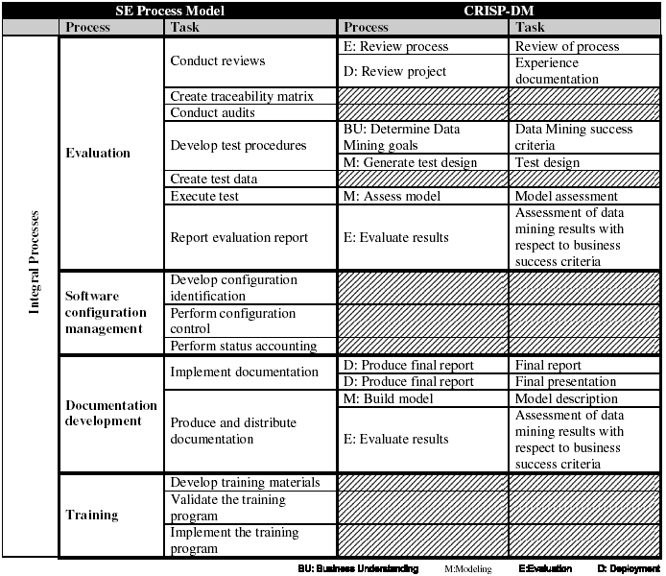

Slide 31
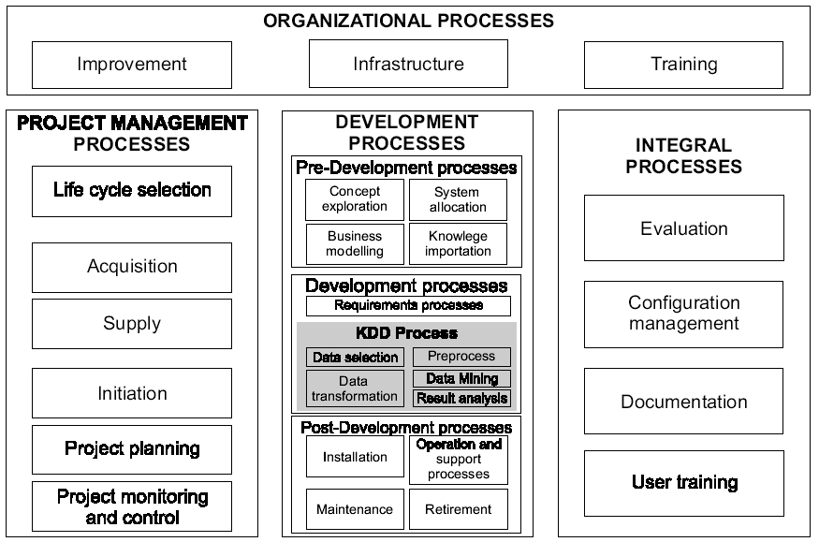
Process Model for DM Engineering

Slide 32
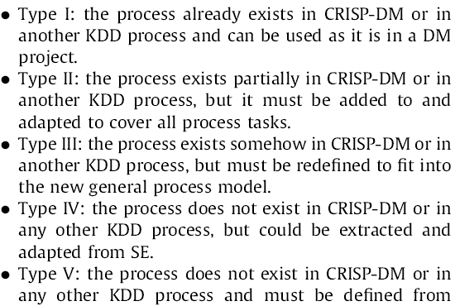
Processes Classification

Slide 33
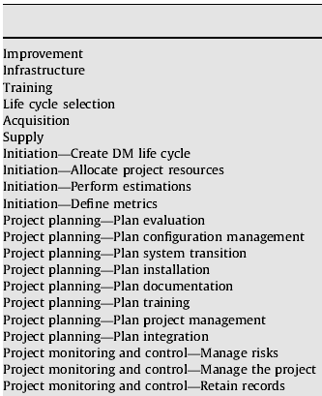
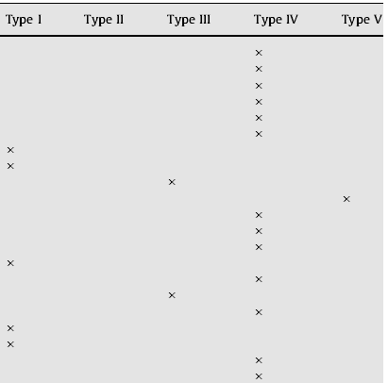
Processes types

Slide 34
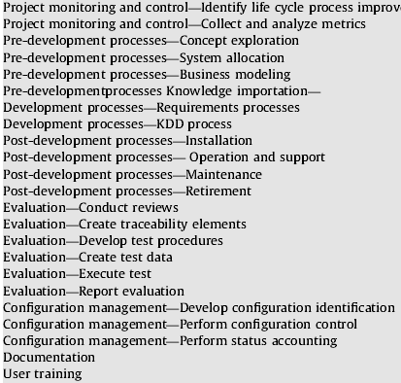

Processes types

Slide 35
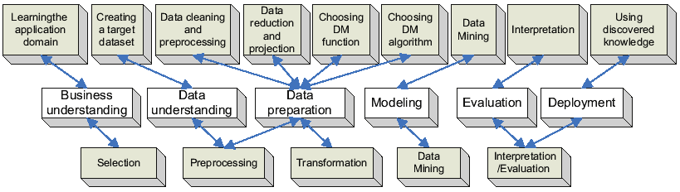
Comparison of KDD and CRISP-DM
KDD
Detail
CRISP-DM
KDD Outline

